Slide 1

LAVAZZA
Business Case Study
TEAM 6

Slide 2


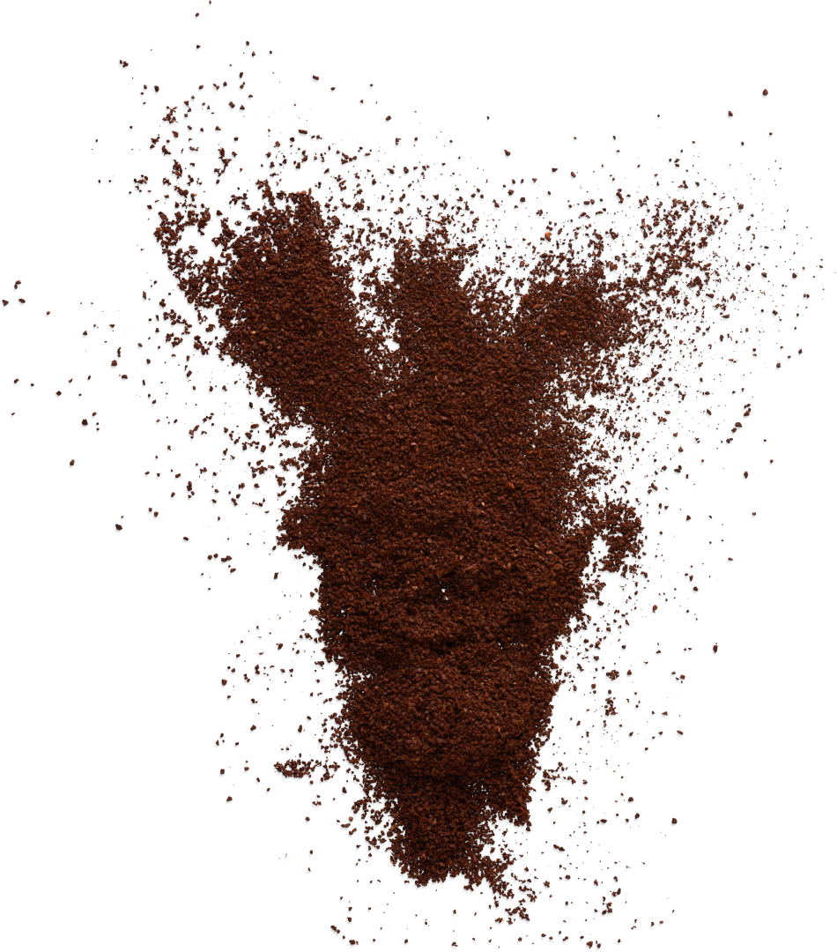
LAVAZZA BUSINESS CASE
TEAM 6
Agenda
1 | Introduction Situation Complication Question Answer
2 | Analysis Decision Visualization Objective & Constraints Business Alternative Comparison Scenario Analysis
3 | Conclusion Recommendations Key Learnings
4 | Conclusion Mathematical Visualization & Objective function Excel Model & Scenarios

Slide 3









LAVAZZA BUSINESS CASE
TEAM 6
Lavazza Overview
Situation
Complication
Italian Coffee Brand
Logistic Challenges
44% Retail Share
Rising costs due to fluctuating market
Reputed Quality
Pressure from large scale Retail chains
Question
Answer
How can Lavazza overhaul its logistics network to improve efficiency, reduce costs, and enhance customer satisfaction?
Linear Trans- Shipment Programming
Key considerations:
1. Where should warehouses be located to best serve customer needs?
2. Which customers should be served from each warehouse?
Minimize handling costs and distribution costs from the central warehouse and satellite warehouse to their six customers while satisfying customers' demands.
Source:
Daily Coffee News Staff (2023) Coffee Consumer Trends: Inside the NCA's Fall 2023 Report
BrandAaron Allen & Associates. (2022, June 22). The Ultimate Guide to the Coffee Shop Industry
Notes:
Situation:
Lavazza, a prestigious coffee company established in 1895, has evolved into a global company renowned for its high-quality coffee blends. Rooted in Turin, Italy, and maintained by four generations of the Lavazza family, it commands a significant market share, particularly in Italy where it leads with about 44% in retail. Over decades, Lavazza's commitment to quality, innovation in roasting and packaging, and strategic market expansion have solidified its status in the global coffee market.
Complication:
Despite its historical success and market leadership, Lavazza faces logistical challenges exacerbated by the late 1990s and early 2000s.
The existing logistics network, once efficient, struggled under the pressure of demand fluctuations and expanded its product range with numerous SKUs, leading to increased operational costs and inefficiencies.
The industry's shift towards centralized storage by major retailers, requiring direct deliveries, further compounded these challenges. To navigate these complexities while ensuring quality service, Lavazza concentrated on improving transportation strategies, specifically between Less Than Truck Load (LTL) and Full Truck Load (FTL).
Question:
Lavazza's situation raises the question of how to strategically overhaul its logistics network to address these inefficiencies, optimize costs, and enhance customer satisfaction. This involves deciding whether to adopt a "make" or "buy" approach for logistics, considering collaborative practices, and determining the most effective logistics network design. The question extends to identifying the optimal warehouse locations and the most efficient distribution. In addition, it requires balancing operational efficiency, cost optimization, and maintaining production quality and reliability for customers.
Answer:
To tackle Lavazza's logistical hurdles, we're using a linear transshipment programming model. This strategy evaluates the costs of six new warehouse options versus their current setup. It helps us find the most cost-efficient design for the logistics network, ensuring we keep costs low while maintaining high service quality. This approach is designed to improve Lavazza's logistics, supporting its leadership in the coffee market and enhancing customer satisfaction.

Slide 4
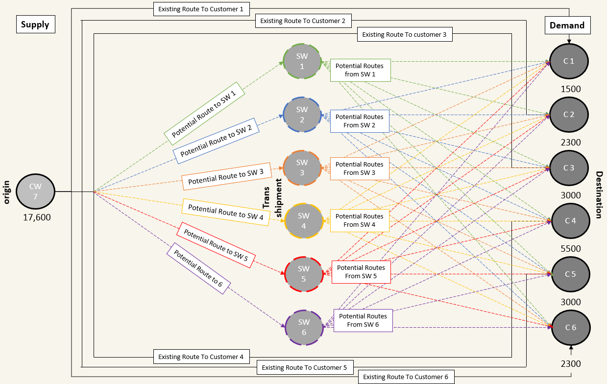

LAVAZZA BUSINESS CASE
TEAM 6
2.1 Business Decision Visualization
Notes:
Due to the centralization of customers during the last ten years, Lavazza is looking to adapt its logistic network to minimize costs.
The current setup consists of a centralized Warehouse (CW 7), which distributes all products to its six customers (C 1-6) via existing routes.
Management believes implementing a satellite warehouse collocated with one of its customers can reduce costs because it will enable Full Truck Loads (FTL).
Hence, the following decisions need to be made:
a) Should a satellite warehouse be implemented?
b) Where should the satellite warehouse be located?
c) Which routes should be used to transport the products?
d) How many products should be transported along each route?
(See appendix for mathematical visualization for the Business Decision)

Slide 5
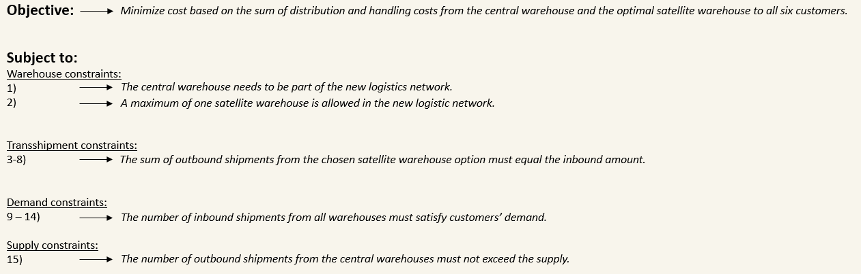
LAVAZZA BUSINESS CASE
TEAM 6
2.2 Business Objective & Constraints
Notes:
Based on the case, the transshipment archetype minimization problem and the cost structure. The following objective and constraints have been derived.
(See appendix for mathematical objective function and constraints)
Objective function:
Minimize cost based on the sum of distribution and handling costs from the central warehouse and the optimal satellite warehouse to all six customers.
Warehouse constraints:
1) The central warehouse must be part of the new logistics network.
2) The new logistic network allows A maximum of 1 satellite warehouse.
Transshipment constraints:
3) The sum of outbound shipments from the satellite warehouse option eight must equal the inbound amount.
4) The sum of outbound shipments from the satellite warehouse option nine must equal the inbound amount.
5) The sum of outbound shipments from the satellite warehouse option ten must equal the inbound amount.
6) The sum of outbound shipments from the satellite warehouse option 11 must equal the inbound amount.
7) The sum of outbound shipments from satellite warehouse option 12 must equal the inbound amount.
8) The sum of outbound shipments from satellite warehouse option 13 must equal the inbound amount.
Demand constraints:
9) The number of inbound shipments from all warehouses must satisfy customer 1’s demand.
10) The number of inbound shipments from all warehouses must satisfy customer 2’s demand.
11) The number of inbound shipments from all warehouses must satisfy customer 3’s demand.
12) The number of inbound shipments from all warehouses must satisfy customer 4’s demand.
13) The number of inbound shipments from all warehouses must satisfy customer 5’s demand.
14) The number of inbound shipments from all warehouses must satisfy customer 6’s demand.

Slide 6
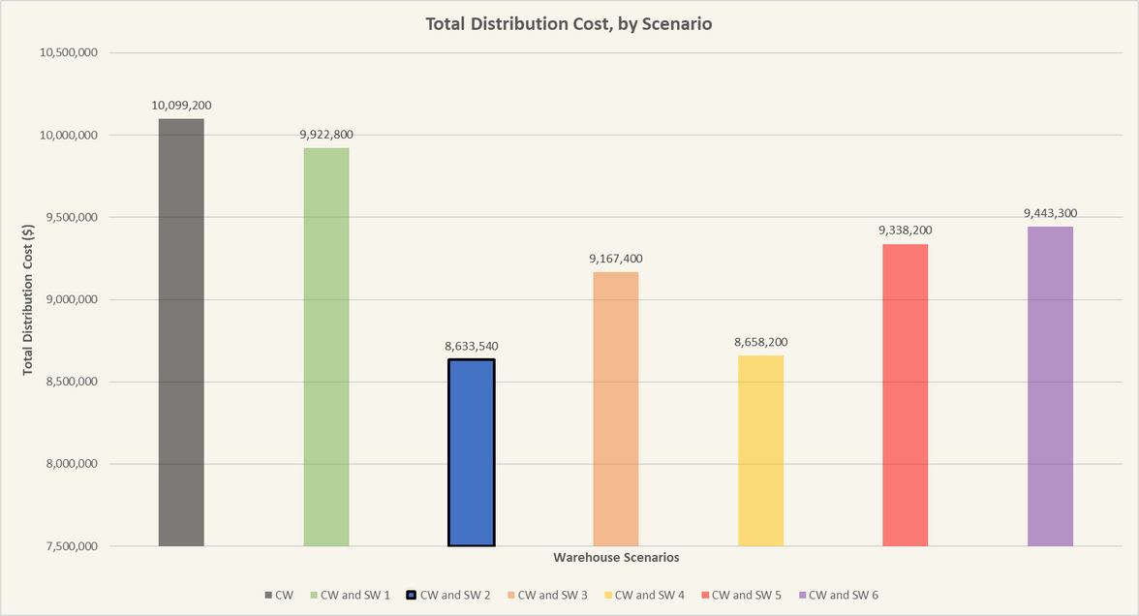
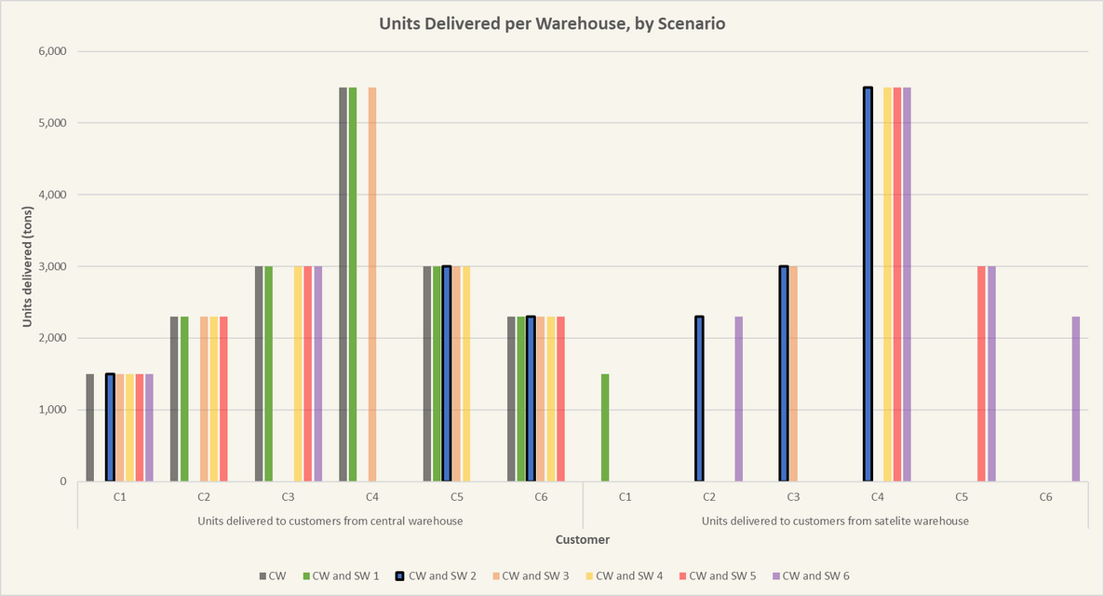
LAVAZZA BUSINESS CASE
TEAM 6
2.3 Business Alternative Comparison
Optimum
Potential
alternative
Notes:
The combination of the Central Warehouse (CW) and Satellite Warehouse 2 (SW2) has resulted in the lowest total cost at $8,633,540, significantly lower than the current setup cost of $10,099,200. This indicates that utilizing SW2 with CW7 is the most cost-effective strategy.
This option distributes all the products to Customers 2,3, and 4 via the Satalite Warehouse and serves all other customers via the Central Warehouse.
Looking at the scenarios containing Satelite Warehouse 1, 3, 5, and 6, we see they are fairly close regarding distribution costs ranging from 9.1 - 9.9 million $.
Looking at the scenario with Satalite Warehouse 4, we see a cost structure initially looking close to SW2. Still, considering one of the assumptions behind the model (No minimum distribution cost for LTL for collocated SW-customer distribution), this is not the case.
What makes SW4 viable is that a large amount of product (5,500 tons) is being transported for free, while what makes SW2 viable is the relatively lower distribution cost compared to the other options.
Because of this, we still recommend that SW2 and management should be cautious when considering SW4 before minimum distribution costs are known and implemented in the model.

Slide 7





LAVAZZA BUSINESS CASE
TEAM 6
2.4 Scenario and Sensitivity Analysis
Demand
Handling Cost
LTL Cost
When customer 4's demand increases by 164
When handling cost of satellite warehouse 2 increases by 66
When LTL cost of delivering from SW2 to Customer 3 increases by 155
Recommendation shifts to Satellite Warehouse 4 across all scenarios
Notes:
The analysis identifies Satellite Warehouse 2 (SW2) as the cost-effective choice for Lavazza’s distribution network under standard cost conditions. The business landscape, however, is subject to fluctuate, with varying demand, handling fees, and transportation costs impacting operational decisions. Understanding and managing these costs is crucial for efficient operations and maintaining competitive pricing (FarEye, 2023).
The sensitivity analysis explores the outcomes of adjusting critical financial levers:
Demand Adjustment: If Customer 4's orders increase by 164 units, the model suggests a potential switch to Satellite Warehouse 4 (SW4) may be warranted to manage costs. This pivot point signals to Lavazza the importance of monitoring sales trends and preparing for distribution adjustments in response to surges in customer demand.
Handling Costs Increase: Should the handling costs at SW2 rise by 66 units, the analysis provides a threshold beyond which the current distribution strategy may warrant reassessment. This insight arms Lavazza with the foresight to anticipate and respond to incremental cost increases in warehouse operations.
LTL Cost Impact: The competitive LTL shipping costs of SW2 play a pivotal role in its selection as the optimal satellite warehouse. However, a scenario analysis reveals that an increase in LTL costs by 155 units, specifically for deliveries from SW2 to Customer 3, could undermine this advantage. In such an event, it becomes more economical to reroute the distribution, switching the focus to Satellite Warehouse 4 (SW4). This warehouse emerges as the next best option due to its alignment with Customer 4, who has the highest demand. This strategic move would minimize the number of shipments required, thus optimizing the network's efficiency and reducing overall transportation expenses.
Collectively, these insights not only question SW2's standing as the optimal satellite warehouse but also highlight the adaptability required in distribution logistics. A single shift in LTL costs could pivot the strategy towards SW4, emphasizing the significance of cost competitiveness and demand concentration in Lavazza's supply chain decisions. This strategic foresight is invaluable as Lavazza navigates market changes and inflationary pressures, empowering the company with a data-backed, flexible approach to their logistics network.

Slide 8
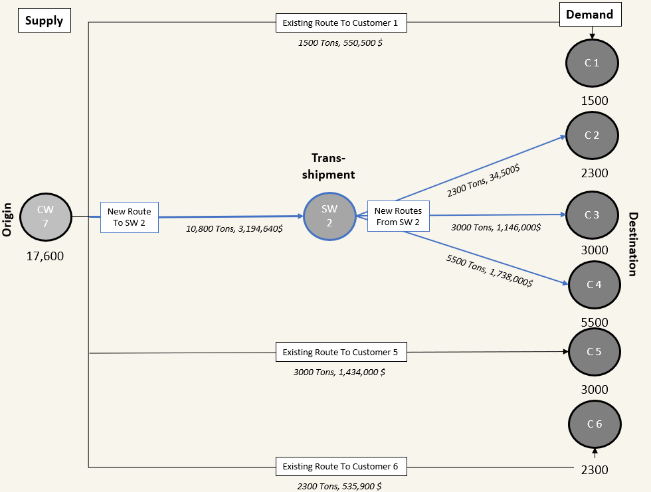
LAVAZZA BUSINESS CASE
TEAM 6
3.1 Recommendations
Investment Recommendations:
Establish Satelite Warehouse 2 (SW2).
Satellite Warehouse Recommendations:
10,800 Tons FTL distribution to SW2.
2,300 Tons LTL distribution to Customer 2.
3,000 Tons LTL distribution to Customer 3.
5,500 Tons LTL distribution to Customer 4.
Central Warehouse Recommendations:
Keep existing LTL routes to Customers 1, 5 & 6.
Cost - Benefit Analysis Result:
The new setup will result in a 1,465,660$ cost saving without sacrificing customer experience.
Notes:
Investment Recommendations:
Establish Satelite Warehouse 2 (SW2)
Satellite Warehouse Recommendations:
10,800 Tons FTL distribution to SW2.
2,300 Tons LTL distribution to Customer 2.
3,000 Tons LTL distribution to Customer 3.
5,500 Tons LTL distribution to Customer 4.
Central Warehouse Recommendations:
Keep existing LTL routes to Customers 1, 5 & 6.
Cost - Benefit analysis:
The new setup will result in a 1,465,660$ cost saving without sacrificing customer experience.

Slide 9
LAVAZZA BUSINESS CASE
TEAM 6
3.2 Key Learnings & Insights
Assumptions & Analytical Limitations:
Assumption 1 - No minimum distribution fee.
Assumption 2 - Identical fixed satellite warehouse cost.
Assumption 3 - Linear handling and transportation cost.
Assumption 4 - No customer-to-customer LTL distribution.
Model output insights:
Robust Model recommendation, with room for a cost increase of up to 66/ton for the most volatile routes and a total cost increase of more than 500,000 $ before satellite warehouse 2 is no longer the optimal solution.
Potential & Future Application:
Mixed non-linear programming model capturing economies of scale in the distribution network.
Large-scale linear programming was applied across all factories in the region.
Notes:
The Linear Programming Model has some analytical limitations due to the assumptions in the model.
First, The model assumes that 3PL partners do not have a minimum distribution fee, which means that the route between customer 2 and the collocated satellite warehouse is free in the model. This is not close to real life, and for a more accurate estimate, we would have to identify the minimum transportation fees.
This is especially skewing the results of e.g. SW4 which looks to be close to the same price point of SW2, which is because a very large quantity is being transported for free due to the above assumption.
Second, the fixed costs for all satellite warehouses are identical. This will not be true in real life since rent/procurement of land and buildings differ depending on location. For a more accurate comparison, we would need to gather individual offers for the different satellite warehouse locations, which might change the model's outcome depending on the time horizon of the investment calculus.
Third, the model assumes a linear trend for both handling and transportation costs. In reality, handling costs would be non-linear due to economies of scale, resulting in marginal productivity increases and marginal labor costs decreases. This might change the outcome of the model, as the model outcome would penalize spreading distribution and incentivize centralizing distribution and handling. For this to be implemented, the model must be changed to a mixed non-linear programming model, and the power of economies of scale must be estimated.
Fourth, the current model does not consider the possibility of using one route to a customer and then continuing from that customer onwards to the next. In reality, this would be possible for the LTL distribution and might reveal a different, more feasible distribution network.
Looking at the model output, sensitivity report, and scenario analysis, we see that the suggested optimal solution is very robust, and cost structures for the least robous route need to change by more than 66$ per ton to alter the route allocation for the optimal solution. In addition, we see that satellite warehouse 2 will be the cheapest option as long as the total distribution cost does not increase by more than 533,860 relative to the second-best option (satellite warehouse 3).
For future applications, we could develop a model that accommodates the previously mentioned assumption via a non-linear model. In addition, we could try to apply the model across all factories in the region to see if we could minimize production and distribution costs for the entire region and not just the specific 6 customers.

Slide 10

THANK YOU

Slide 11
LAVAZZA BUSINESS CASE
TEAM 6
Reference list
BrandAaron Allen & Associates. (2022, June 22). The Ultimate Guide to the Coffee Shop Industry.
https://aaronallen.com/blog/coffee-shop-industry
Daily Coffee News Staff. (2023). Coffee Consumer Trends: Inside the NCA's Fall 2023 Report.
https://dailycoffeenews.com/2023/09/19/coffee-consumer-trends-inside-the-ncas-fall-2023-report/#:~:text=Overall%20Consumption,coffee%20within%20the%20past%20day.
FarEye. (2023). What Is Transportation Cost?
https://fareye.com/resources/blogs/what-is-transportation-cost

Slide 12

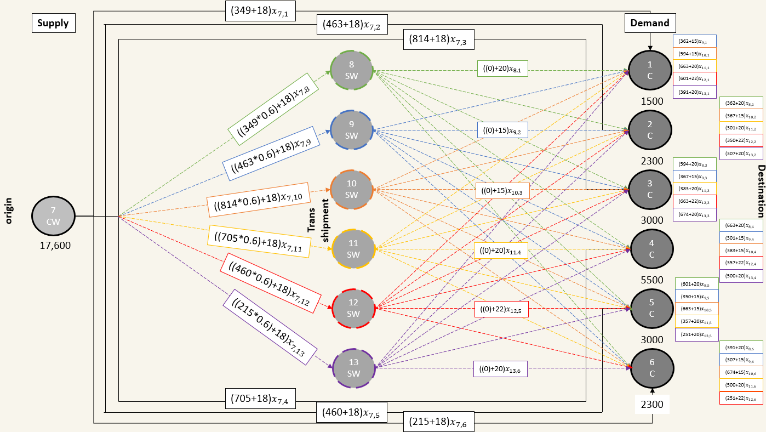
Appendix 1 - Mathematical Visualization

Slide 13
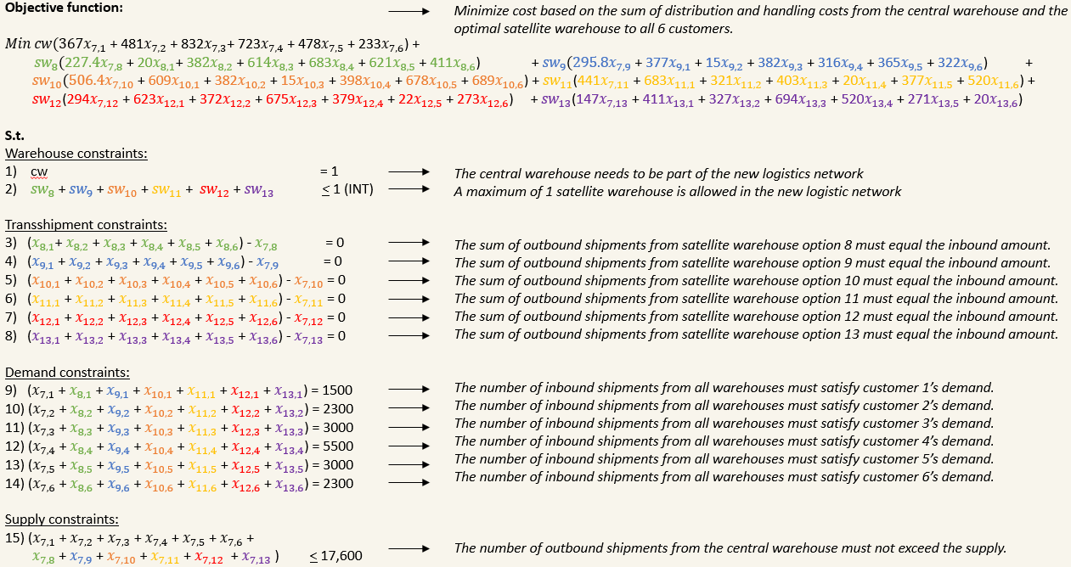
Appendix 2 - Mathematical Objective

Slide 14


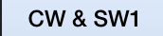
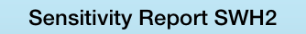



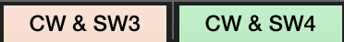
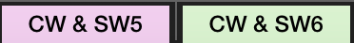
Appendix 3
Guide on how to read the excel: Sheet Names and Descriptions
Sheet Name | Description of Sheet | Rationality of Sheet
 | Contains the original model with optimal results and summary results of each simulation | To be able to formulate in excel the model that we have formed
 | Simulated scenario of having the original set-up where all deliveries are coming from central warehouse | To have a baseline of the current cost of distribution and be able to compare it with each satellite warehouse cost
 | Model result if satellite warehouse 1 is activated while all others are not | Since there are constraints in excel, we tried removing the binary variables as decision variables and just put the value of satellite WH 1 as equal to 1 to see how the model will allocate the units between central warehouse vs satellite warehouse 1
 | Model result if satellite warehouse 2 is activated while all others are not | Similar to CW & SW1 sheet but activating satellite warehouse 2 instead. As we saw in the summary and would see based on the results of each satellite warehouse scenario, this model has the lowest cost and therefore, the optimal solution
 | Sensitivity report of satellite warehouse 2 simulation | This sheet contains our basis in checking out the different scenarios that would shift our optimal solution from satellite 2 to the next lowest cost which is satellite warehouse 4
 | Scenario Planning a. Increasing the demand of customer 4 b. Increasing the handling costs c. Increasing the LTL costs | Through scenario planning, we were able to observe what effects will increasing the demand, handling costs, and LTL costs have on the model. And it was found that, Satellite Warehouse 4 became more cost effective over SW2 at a certain point.
 | Model result if satellite warehouse 3 to 6 is activated while all others are not. Each satelite warehouse have separate sheets | Model result if satellite warehouse 3 to 6 is activated while all others are not. Each satelite warehouse have separate sheets
Notes:
Navigating each sheet:
Original Model: This sheet lays the foundation for our analysis, featuring the primary linear programming model complete with variables and constraints. It represents our approach to optimizing Lavazza's distribution network, with a focus on minimizing costs while meeting customer demand. The results here serve as the benchmark for our subsequent scenario analyses.
CW Only (As is): Here, we present a 'status quo' scenario where all products are distributed directly from the central warehouse. This sheet helps us quantify the current distribution costs, which we'll compare against other scenarios to evaluate potential cost savings from different warehouse configurations.
CW & SW1: This sheet explores a scenario where only Satellite Warehouse 1 is utilized alongside the central warehouse. It allows us to assess the impact on overall costs when distribution is split between the central warehouse and SW1. We've modeled this scenario to see how it stands against our base case in terms of efficiency and cost-effectiveness.
CW & SW2 - Optimal Solution: This scenario activates only Satellite Warehouse 2, which our analysis identifies as the most cost-effective option. The model in this sheet incorporates specific costs and logistical details pertinent to SW2, showing why it emerges as the optimal solution among all satellite warehouses considered.
Sensitivity Report SWH2: The sensitivity report for Satellite Warehouse 2 is critical for understanding the robustness of our model. It examines how sensitive the optimal solution is to changes in key parameters, such as transportation rates and demand patterns. This analysis helps us gauge the reliability of our recommendations under varying market conditions.
CW & SW3 to CW & SW6: Each of these sheets simulates the activation of one additional satellite warehouse (from SW3 to SW6) while keeping others inactive. These individual scenarios let us isolate and understand the unique contributions and limitations of each satellite warehouse to the overall distribution network.

Slide 15
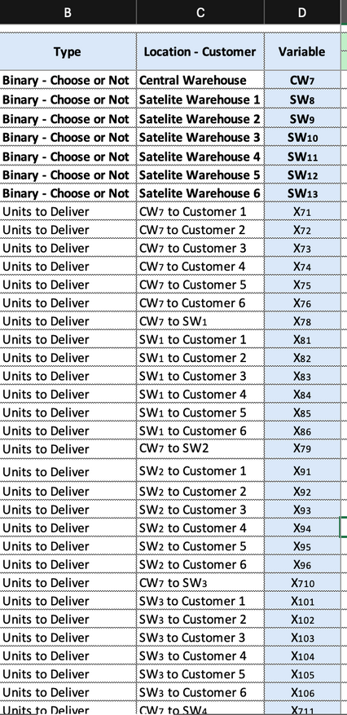
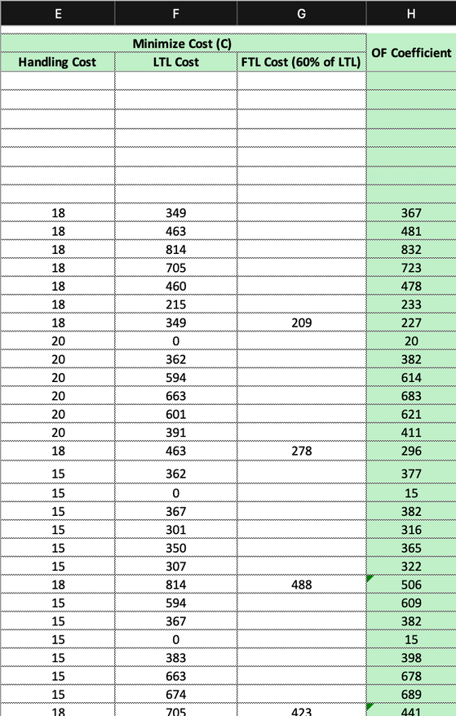
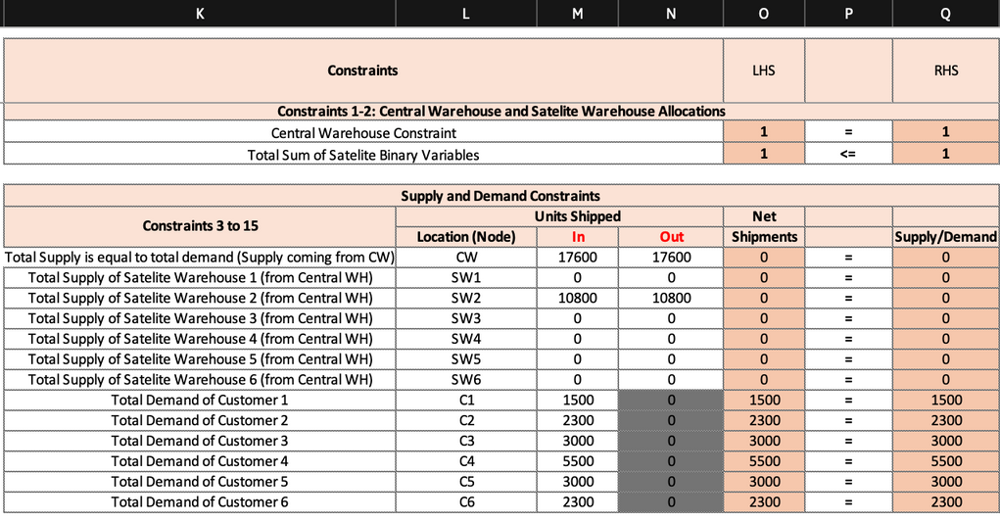
Appendix 4
Guide on how to read the excel: Understanding the Model
Columns E to H shows all the elements of cost for the objective function coefficient of each decision variable
Column I indicates the final value that the solver generated
Columns B to D indicates all our decision variables
Objective function is indicated in cell L25 which is the sumproduct of column H (OF coefficient) and I (final value of units to distribute) per warehouse multiplied by its binary constraint if it is activated
These areas represents the different constraints where column O represents the Left hand side while Q represents right hand side
The first two constraints are coming from the binary variables from rows 4 to 10 to represent whether we would be using the warehouse or not
Constraints 3 to 15 talks about the supply and demand constraints where:
Row11: Total supply will all be coming from central warehouse and will be distributed to either customers 1 to 6 or satellite warehouses with a net shipment of 0
Rows 12 to 17: total supply of satellite warehouses will come from central warehouse if activated (via multiplying binary constraint), then will be delivered to different customers
Rows 18 to 23: total supply of customer will be coming from either central warehouse directly or satelite warehouses and total value is equal to demand
Notes:
Understanding the model sheets in excel:
Decision Variables Explanation:
Our model uses decision variables listed in Columns B to D to determine how many units should be shipped from each warehouse to satisfy customer demand while minimizing costs. These variables form the core of our optimization model, enabling us to explore various distribution strategies.
Understanding Cost Components:
The costs associated with shipping from each warehouse to the customers are broken down into handling costs, LTL (less-than-truckload), and FTL (full truckload), displayed in Columns E to H. These are the cost factors that our model seeks to minimize, and they form the coefficients in our objective function.
Objective Function and Results:
The objective function, located in Cell L25, calculates the total cost by multiplying each decision variable by its cost coefficient and summing these products. The solver's task is to find the set of decision variable values that minimizes this total cost, which is displayed in Column I as the final values.
Constraints Detailing:
Our constraints are expressed in the matrix spanning Columns K to Q. These constraints enforce the rules of our supply chain, including warehouse capacities and customer demands. The left-hand side (Column O) represents the calculated supply or demand based on the decision variables, while the right-hand side (Column Q) lists the required supply or demand levels.
Model Adaptations for Other Sheets:
In subsequent sheets (such as CW & SW1, CW & SW2, etc.), we have adapted the original model by setting the decision variable for each satellite warehouse equal to one, effectively 'activating' that warehouse. By doing this, we eliminate the need for binary variables and simplify the model while still imposing a condition that only one satellite warehouse is operational at a time. This allows us to isolate the impact of each satellite warehouse on the overall distribution costs.
Comparing Across Scenarios:
By comparing the objective function results across these adapted sheets, we can assess which single satellite warehouse scenario offers the most cost-effective solution. We use the same model structure as in the Original Model sheet, with the only change being the fixed use of one satellite warehouse at a time.
Implications of Model Findings:
The insights gained from this analysis inform strategic decisions about which satellite warehouse Lavazza should activate to achieve cost savings in its distribution network. It's a comprehensive approach that balances the need to meet customer demands with the goal of cost efficiency in logistics.

Slide 16
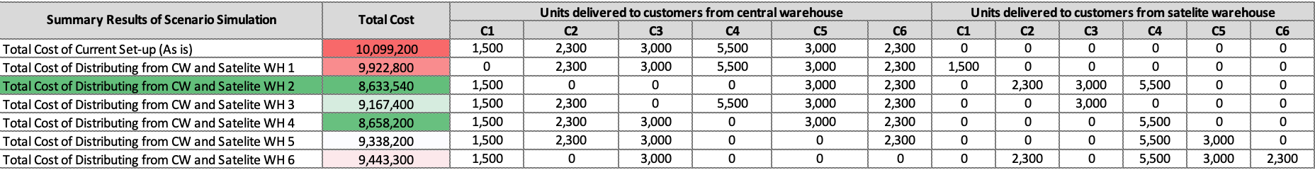
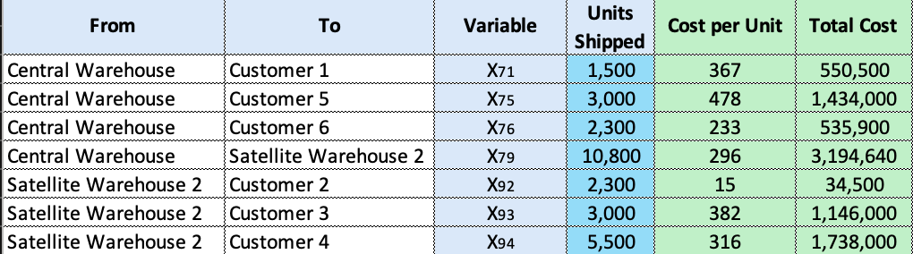
Appendix 5
Guide on how to read the excel: Summary Results Shown in Model Sheet
To make the comparison of results easier to comprehend, we have put in columns K to X from row 21 to 29 the summary of the results of each model that we have simulated.
Column K: shows the different model combinations starting from current set-up then to activating each of the satellite warehouse
Column L: shows the objective function results of the model when simulated
Columns M to Q: shows the units delivered per customer from the central warehouse as indicated by the final values of the decision variables in the model
Columns S to X: shows the units delivered per customer from the satelite warehouse as indicated by the the final values of the decision variables in the model
Results: as shown in the summary above, comparing all 7 generations of the model deemed investing in warehouse 2 is the most cost effective choice. Here is a summary of the units and cost of the optimal solution:
Notes:
Summary Results Explanation:
This section of the appendix illustrates a comprehensive comparison of the total distribution costs across all scenarios, including the current setup and each satellite warehouse option. The summary is designed to provide a clear depiction of the cost implications associated with each distribution strategy.
Column Descriptions:
Column K: Lists each scenario that was simulated, starting with the current setup and proceeding through the various configurations involving the activation of each satellite warehouse.
Column L: Shows the total cost for each scenario, which is the key metric for our analysis. It represents the sum of all costs associated with distributing products from the central warehouse and any activated satellite warehouse to the customers.
Columns M to X: Present the detailed results of the distribution quantities from the central and satellite warehouses to the customers. This includes units delivered from the central warehouse (Columns M to Q) and units delivered from the satellite warehouses (Columns S to X).
Optimal Solution Summary:
The model's analysis indicates that activating Satellite Warehouse 2 yields the most cost-effective solution. The lower section of the appendix provides a detailed breakdown of the shipments in this optimal scenario, with specifics on the units shipped to each customer from the central warehouse and Satellite Warehouse 2, the cost per unit, and the resulting total cost for each route.
Interpreting the Model's Results:
These results demonstrate the potential cost savings that Lavazza can realize by optimizing their distribution network. The scenario with Satellite Warehouse 2 activated leads to significant cost reductions compared to the current setup and the other satellite warehouse options.
Implications for Decision-Making:
The data presented in this appendix will support strategic decision-making regarding Lavazza's distribution network redesign. By clearly showing the cost benefits of utilizing Satellite Warehouse 2, we provide compelling evidence to support the investment in this particular warehouse as part of the company's efforts to enhance distribution efficiency and reduce costs.

Slide 17
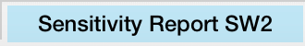
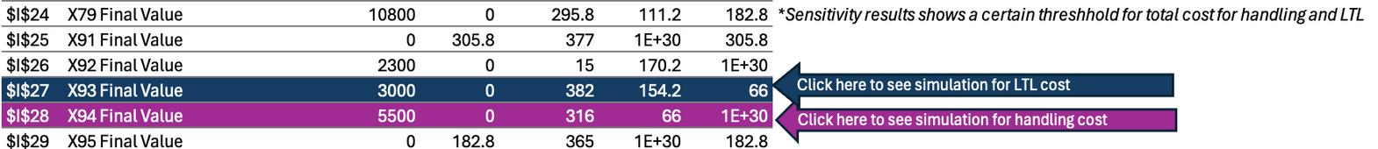
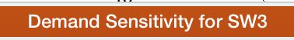

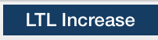
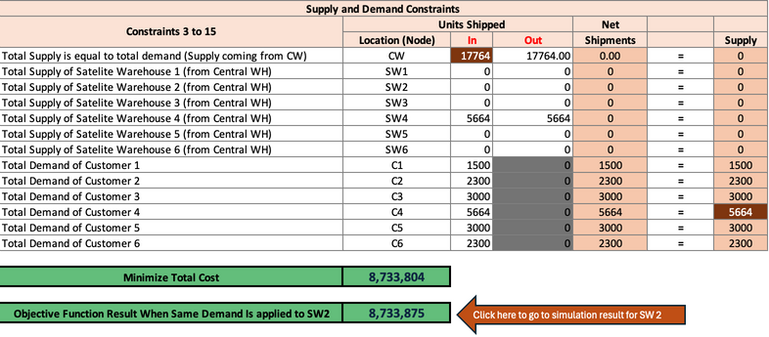
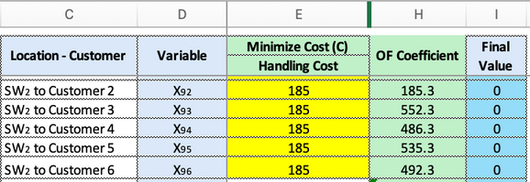
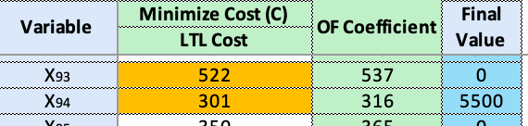
Appendix 6
Guide on how to understand the three scenarios
Compares the result of SW4's sensitivity result to get the number of units to increase in the demand to analyze results
Uses the baseline number of allowable increase to analyze impact of handling cost (min 155)
Uses the baseline number of allowable increase to analyze impact of handling cost (min 66)
2 cases were observed. Handling costs changes were made such that in one case - the objective function coefficient remained within the allowable increase range and in other case it exceeded the allowable increase range. Handling costs changes were made across all the variables belonging to SW2.
On both cases, the results increased the cost which results to having satellite warehouse 4 the optimal cost vs satellite warehouse 2
2 cases were observed - for variable X93 and X94. LTL costs changes were made such that in X94 - the objective function coefficient exceeded the allowable increase range and in X93 it stayed within the allowable range.
Both resulted in a shift in proposed solution to warehouse satellite 4 as the lowest cost
Added 164 to the total demand for customer 4, which changed the total demand for customer 4 to 5,664.
The change was applied to supply constraint and customer 4 demand constraint
Results showed that simulating the changes in demand shifted the results
Notes:
This appendix is designed to guide stakeholders through the sensitivity analysis conducted for the Lavazza business case, focusing on three key scenarios: demand sensitivity for SW3, handling costs increase, and LTL cost increase.
Demand Sensitivity for SW3:
The model adjusts the demand for Customer 4 and observes the impact on the distribution network.
An increase of 164 units to Customer 4's demand necessitates a re-evaluation of the optimal satellite warehouse, with a potential shift towards SW4 due to its capacity to efficiently handle the increased load.
The results underscore the importance of adapting distribution strategies in response to dynamic customer demands.
Handling Costs Increase:
This scenario tests the robustness of the distribution network against increases in handling costs at SW2.
Two cases are compared: one where the cost increase remains within a manageable range and another where it exceeds this range, prompting a reassessment of the cost-benefit balance.
Both cases highlight how sensitive the network's cost-efficiency is to handling cost variations, influencing the strategic choice of the satellite warehouse.
LTL Cost Increase:
An LTL cost increase for deliveries from SW2 to Customer 3 is analyzed to determine its impact on the overall distribution cost.
The analysis reveals that SW2's viability is highly dependent on maintaining competitive LTL rates. A significant increase could shift the cost advantage to SW4, which is positioned as a more economical option due to high demand from Customer 4, thus potentially reducing overall shipment volumes and associated costs.
Navigating the Results:
Each scenario's results are captured concisely, enabling decision-makers to assess the potential implications for Lavazza's distribution strategy.
The scenarios facilitate a proactive approach to potential market changes, providing Lavazza with the data needed to make informed decisions and maintain cost efficiency.
By navigating through these sheets, stakeholders can visualize how each variable affects the network and why maintaining flexibility in the distribution strategy is crucial.

